Slide 1
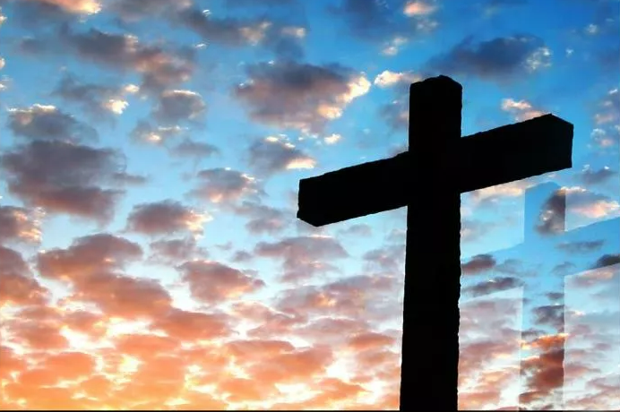
Loving God Back Means Surrendering Your Life to Build the Kingdom of His Dear Son
Ephesians 4:11-16
Notes:
Eddie Williams ~ April 23, 2023
~ October 8, 2023
~ October 22, 2023 (completion)
~ September 22, 2024
~ May 4, 2025
~ October 5, 2025

Slide 2
Ephesians 4:11-16 (NLT)
¹¹ Now these are the gifts Christ gave to the church: the apostles, the prophets, the evangelists, and the pastors and teachers. ¹² Their responsibility is to equip God's people to do his work and build up the church, the body of Christ.

Slide 3
Ephesians 4:11-16 (NLT)
¹³ This will continue until we all come to such unity in our faith and knowledge of God's Son that we will be mature in the Lord, measuring up to the full and complete standard of Christ.

Slide 4
Ephesians 4:11-16 (NLT)
¹⁴ Then we will no longer be immature like children. We won't be tossed and blown about by every wind of new teaching. We will not be influenced when people try to trick us with lies so clever they sound like the truth.

Slide 5
Ephesians 4:11-16 (NLT)
¹⁵ Instead, we will speak the truth in love, growing in every way more and more like Christ, who is the head of his body, the church.

Slide 6
Ephesians 4:11-16 (NLT)
¹⁶ He makes the whole body fit together perfectly. As each part does its own special work, it helps the other parts grow, so that the whole body is healthy and growing and full of love.

Slide 7
Five Points:
Surrender = Stop Resisting GOD and Submit to His Authority, His Will for Your Life. What is Your Spiritual Gift? Are You Using It?
Your Body is Not Your Own.
Build the Kingdom.
Kingdom of His Dear Son.
Are You Involved with Building the Kingdom, Not Just Coming to Worship?

Slide 8
Point #1: Surrender = Stop Resisting GOD and Submit to His Authority, His Will for Your Life.
What is Your Spiritual Gift?
Are You Using It?
Matthew 16:24-26 (NLT)

Slide 9
Matthew 16:24-26 (NLT)
²⁴ Then Jesus said to his disciples, "If any of you wants to be my follower, you must give up your own way, take up your cross, and follow me.

Slide 10
Matthew 16:24-26 (NLT)
²⁵ If you try to hang on to your life, you will lose it. But if you give up your life for my sake, you will save it.

Slide 11
Matthew 16:24-26 (NLT)
²⁶ And what do you benefit if you gain the whole world but lose your own soul? Is anything worth more than your soul?

Slide 12
Point #2: Your Body is Not Your Own
I Corinthians 6:15-20 (NLT)

Slide 13
I Corinthians 6:15-20 (NLT)
¹⁵ Don't you realize that your bodies are actually parts of Christ? Should a man take his body, which is part of Christ, and join it to a prostitute? Never!

Slide 14
I Corinthians 6:15-20 (NLT)
¹⁶ And don't you realize that if a man joins himself to a prostitute, he becomes one body with her? For the Scriptures say, "The two are united into one."

Slide 15
I Corinthians 6:15-20 (NLT)
¹⁷ But the person who is joined to the Lord is one spirit with him.
¹⁸ Run from sexual sin! No other sin so clearly affects the body as this one does. For sexual immorality is a sin against your own body.

Slide 16
I Corinthians 6:15-20 (NLT)
¹⁹ Don't you realize that your body is the temple of the Holy Spirit, who lives in you and was given to you by God? You do not belong to yourself,

Slide 17
I Corinthians 6:15-20 (NLT)
²⁰ for God bought you with a high price. So you must honor God with your body.

Slide 18
Point #3: Build the Kingdom
Matthew 28:19-20 (KJV)
Acts 8:4 (KJV)

Slide 19
Matthew 28:19-20 (KJV)
¹⁹ Go ye therefore, and teach all nations, baptizing them in the name of the Father, and of the Son, and of the Holy Ghost:

Slide 20
Matthew 28:19-20 (KJV)
²⁰ Teaching them to observe all things whatsoever I have commanded you: and, lo, I am with you always, even unto the end of the world. Amen.

Slide 21
Acts 8:4 (KJV)
Therefore they that were scattered abroad went every where preaching the word.

Slide 22
Point #4: Kingdom of His Dear Son
Matthew 16:18-19 (KJV)
Colossians 1:12-14 (NLT)

Slide 23
Matthew 16:18-19 (KJV)
¹⁸ And I say also unto thee, That thou art Peter, and upon this rock I will build my church; and the gates of hell shall not prevail against it.

Slide 24
Matthew 16:18-19 (KJV)
¹⁹ And I will give unto thee the keys of the kingdom of heaven: and whatsoever thou shalt bind on earth shall be bound in heaven: and whatsoever thou shalt loose on earth shall be loosed in heaven.

Slide 25
Colossians 1:12-14 (NLT)
¹² always thanking the Father. He has enabled you to share in the inheritance that belongs to his people, who live in the light.

Slide 26
Colossians 1:12-14 (NLT)
¹³ For he has rescued us from the kingdom of darkness and transferred us into the Kingdom of his dear Son, ¹⁴ who purchased our freedom and forgave our sins.

Slide 27
Point #5: Are You Involved with Building the Kingdom, Not Just Coming to Worship?
I Corinthians 15:58 (KJV)
Matthew 6:33 (KJV)
Acts 20:22-27 (NLT)

Slide 28
I Corinthians 15:58 (KJV)
Therefore, my beloved brethren, be ye stedfast, unmoveable, always abounding in the work of the Lord, forasmuch as ye know that your labour is not in vain in the Lord.

Slide 29
Matthew 6:33 (KJV)
But seek ye first the kingdom of God, and his righteousness; and all these things shall be added unto you.

Slide 30
Acts 20:22-27 (NLT)
²² "And now I am bound by the Spirit to go to Jerusalem. I don't know what awaits me,
²³ except that the Holy Spirit tells me in city after city that jail and suffering lie ahead.

Slide 31
Acts 20:22-27 (NLT)
²⁴ But my life is worth nothing to me unless I use it for finishing the work assigned me by the Lord Jesus—the work of telling others the Good News about the wonderful grace of God.

Slide 32
Acts 20:22-27 (NLT)
²⁵ "And now I know that none of you to whom I have preached the Kingdom will ever see me again.
²⁶ I declare today that I have been faithful. If anyone suffers eternal death, it's not my fault,

Slide 33
Acts 20:22-27 (NLT)
²⁷ for I didn't shrink from declaring all that God wants you to know.

Slide 34

…that Christ died for our sins according to the scriptures;
And that he was buried, and that he rose again the third day according to the scriptures:

Slide 35
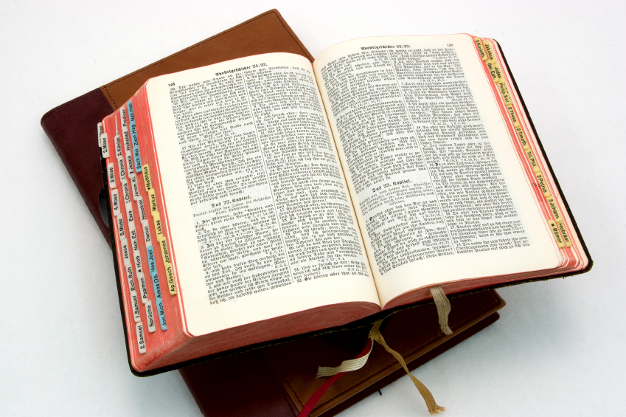
Hear: Romans 10:17
So then faith cometh by hearing, and hearing by the word of God.

Slide 36
Believe: Hebrews 11:6
But without faith it is impossible to please him: for he that cometh to God must believe that he is, and that he is a rewarder of them that diligently seek him.

Slide 37
Repent: Luke 13:3
I tell you, Nay: but, except ye repent, ye shall all likewise perish.

Slide 38
Confess: Matthew 10:32-33
32 Whosoever therefore shall confess me before men, him will I confess also before my Father which is in heaven.
33 But whosoever shall deny me before men, him will I also deny before my Father which is in heaven.

Slide 39
Baptize: Acts 22:16
And now why tarriest thou? arise, and be baptized, and wash away thy sins, calling on the name of the Lord.

